Slide 1
REAL TIME SPEECH STEGANOGRAPHY FOR SECURE DATA TRANSMISSION
Internal Guide:-
S Surekha
Assistant Professor
Batch- B16
Sabah Samareen (19321A04A9)
Saniya Naaz (19321A04C0)
P Meghana Reddy(19321A0472)
1

Slide 2
CONTENTS
Objective
Abstract
Introduction- Steganography
Software Requirements
Block diagram
Existing Method
DWT
Algorithm
Expected Results and Discussion
Noise Attack
Applications
References
2

Slide 3
OBJECTIVE
To perform Real Time Speech Steganography for Secure
Data Transmisson by Discrete Wavelet Transform using MATLAB
3

Slide 4
ABSTRACT
Information hiding into a cover object is referred as steganography. Here the cover object might be an image, video, or speech. Speech steganography is a process of hiding message data into a cover speech without degrading the quality of cover speech. Here, a spread spectrum representation-based speech steganography using discrete wavelet transform (DWT), which decomposes the cover speech signal into approximated and detail coefficients i.e., low frequency and high frequency has been introduced. The proposed speech steganography provides enhanced imperceptibility since DWT reconstructs the decomposed information without degrading the quality of speech. This approach is an extended version of existing Fast fourier transform (FFT) based steganography, where there is a lack of imperceptibility. Simulation results proved that the proposed algorithm is superior to the conventional algorithms. Also performed good enough simulations with low bit error rate and excellent imperceptibility
4

Slide 5
INTRODUCTION STEGANOGRAPHY
Steganography refers to hiding information or any secret message behind a cover object which might be an image, speech or video.
Persons who are authorized recipients can only view the message sent from the source end.
5

Slide 6
To obtain an effective steganography, one must need the following:
Cover object to hide the secure information.
Secret information i.e., message.
Embedding procedure to get a stego information.
4. Extraction process to reconstruct secret message at recipient.
6

Slide 7
SOFTWARE REQUIREMENTS
Operating System:- Windows 11
Coding Language:- MATLAB
Tool:- MATLAB 2018a
7

Slide 8
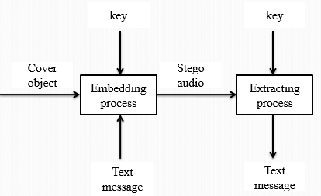
BLOCK DIAGRAM
8

Slide 9
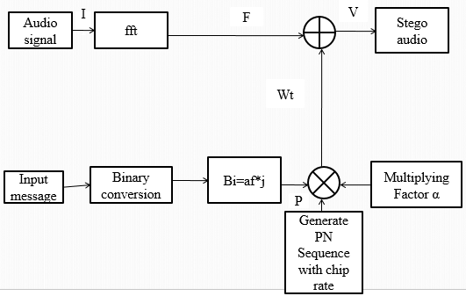
EXISTING METHODOLOGY
9

Slide 10
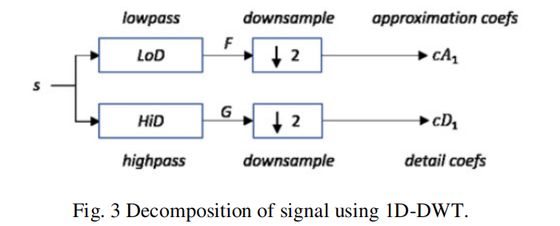
DISCRETE WAVELET TRANSFORM
Advanced transformation technique
Decomposes the input speech signal into approximate and detail coefficients
10

Slide 11
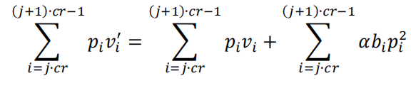
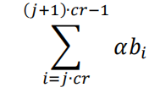

ALGORITHM
A={$a_{i}$| $a_{i}$ ∈ −1,1}--------------------(1)
P={$p_{i}$| $p_{i}$ ∈ −1,1}--------------------(2)
B={$b_{i}$| $b_{i}=a_{i}$,j.cr <= I < (j+i).cr}------(3)
$w_{i.}=$.$b_{i }.p_{i}$ -----------------(4)
$v_{i}^{′}=v_{i}+w_{i}$ -------------------(5)
.
----------------------------------------(6)
.
--------------------------------(7)
11

Slide 12
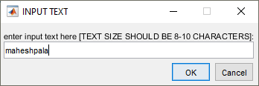
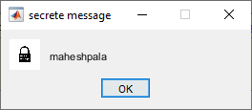
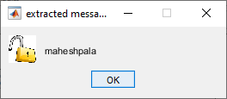
EXPECTED RESULTS AND DISCUSSION
Entering secret message to be
embedded.
Embedded message.
Extracted message with proposed implementation.
12

Slide 13
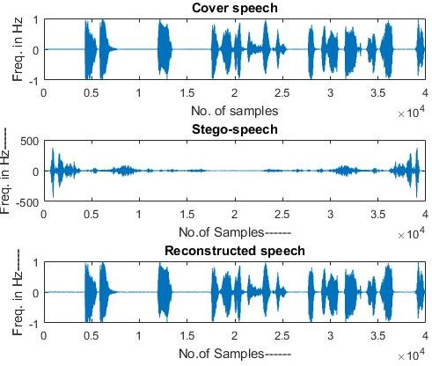
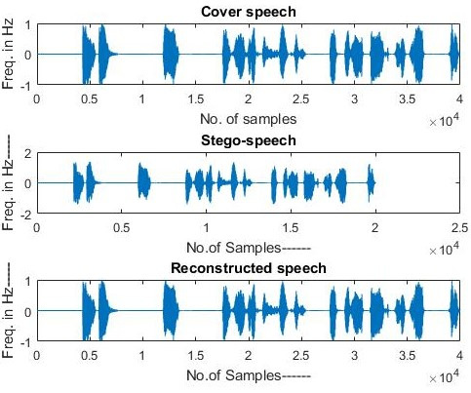
Performance of FFT-based speech steganography
Performance of proposed speech steganography
13

Slide 14
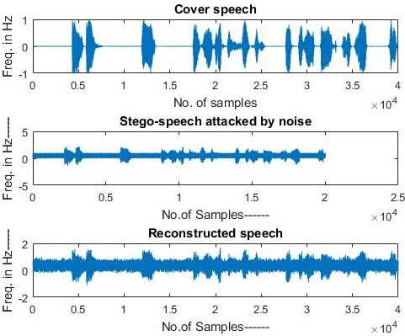
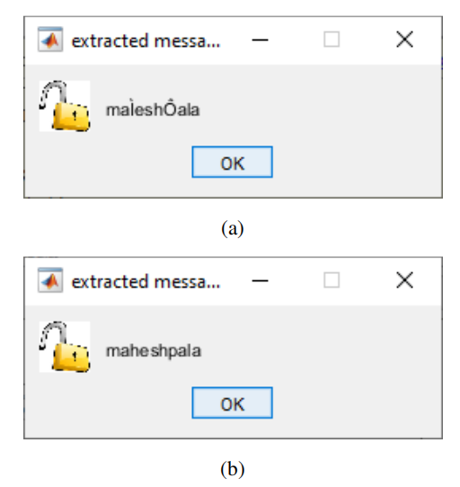
NOISE ATTACK
Obtained results of proposed speech steganography with noise attack
FFT steganography
(b)DWT steganography.
14

Slide 15
ADVANTAGES OF DWT
Performs highly imperceptible steganography
Wavelets represent real world data better than sinusoids
Captures frequency and location information (location in time)
Difficult to choose which basis to use.
More resources (memory) required to perform the computation
DISADVANTAGES OF DWT
15

Slide 16
APPLICATIONS
Confidential communication and secret data storing
Protection of data alteration
Digital Watermarking
16

Slide 17
REFERENCES
[1] S. Yang, Z. Song and J. H. Park, “High capacity CDMA Watermarking Scheme based on orthogonal Pseudo random subspace projection,” International Conference on Multimedia and Ubiquitous Engineering, Jun. 2011.
[2] L. Fillatre, “Adaptive Steganalysis of Least Significant Bit Replacement in Grayscale Natural Images,” IEEE Transactions on Signal Processing, vol. 60, no. 2, Feb. 2012.
[3] R. R. Ahirwal, D. C. Ahirwal and J. Jain, “A High Capacitive and Confidentiality based Image Steganography using Private Stego key,” International coference on Information Science and applications, Feb. 2010.
[4] R. M. Naguraha, “Implementation of Direct sequence Spread Spectrum on Audio Data,” International Conference on Informatics Engineering, Jun. 2011.
[5] S. Rekik, D. Guerchi,H. Hamam and S.-A. Selouani, “Audio Steganography Coding Using the Discrete Wavelet Transforms,”International Journal of Computer Science and Security, vol. 6, no. 1, 2012.
17

Slide 18
THANK YOU
18

